Slide 1



Welcome to the Timeline Chart Workshop!
🎥 Recording will be shared
Download Code & Slide
Sign Up For:
Asking Questions & Raising Hands
bit.ly/KDP_Timeline
Click the top right Download ZIP button
#1 Developer Account bit.ly/KDP_signup
#2 Kintone Subdomain bit.ly/K_DevLic
Post questions in the chat anytime!
Include your code & error messages.
$25 Gift Card Raffle at the End
Notes:
* Download the Zip file from GitHub Gist at http://bit.ly/KDP_Timeline
It contains all the files you need for this workshop
There are two accounts to sign up for to take full advantage of this workshop
First, sign-up to the Kintone Developer Program (first link)
After obtaining your account, sign up for the Developer License.
Needless to say, if you already have made an Kintone account, please use your already made Developer License
Ask questions anytime throughout this workshop via chat!
Stick around till the end to enter a $100 Amazon Gift Card raffle!

Slide 2
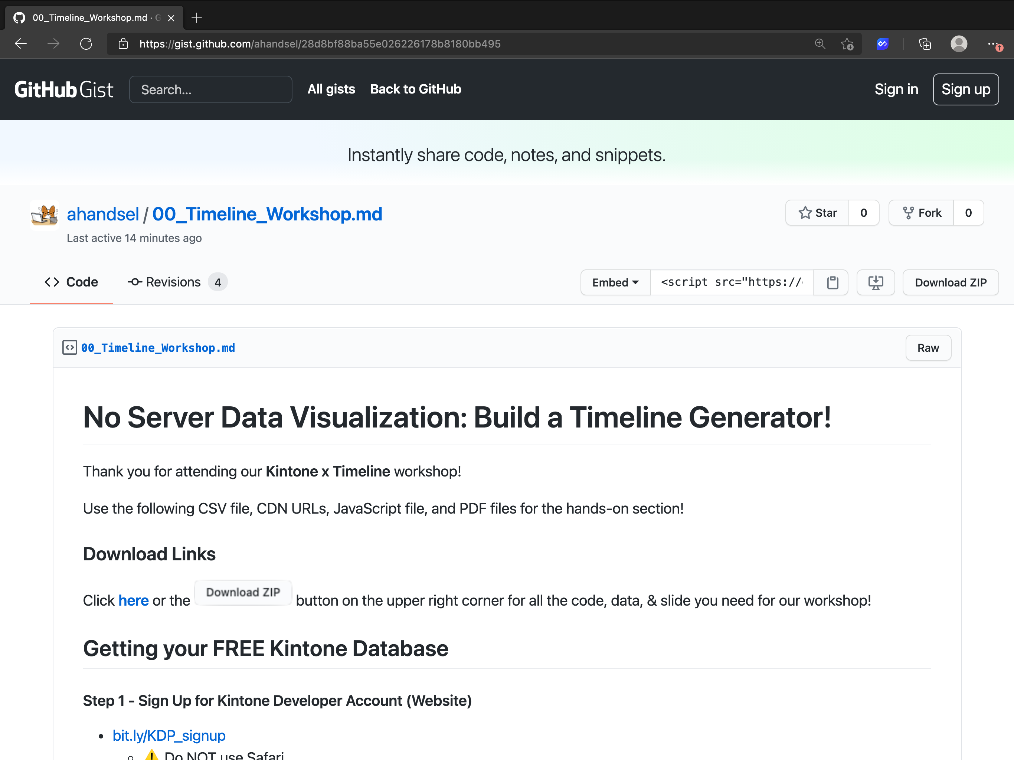
Click here to download EVERYTHING
Scroll down to view the other files
Notes:
http://bit.ly/KDP_Timeline

Slide 3

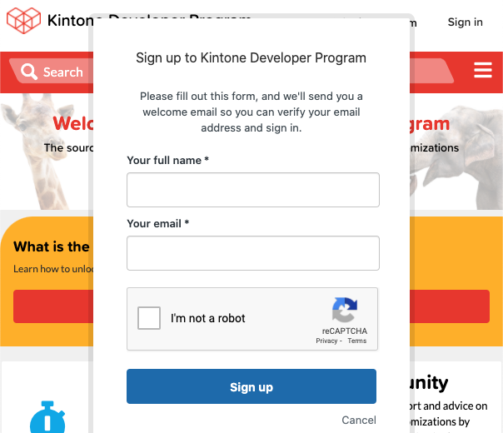
#1 - Sign Up for Developer Account
bit.ly/KDP_signup
⚠️ Do NOT use Safari ⚠️
⚡Accept Cookies First⚡
✅ Chrome & Firefox works ✅

Slide 4
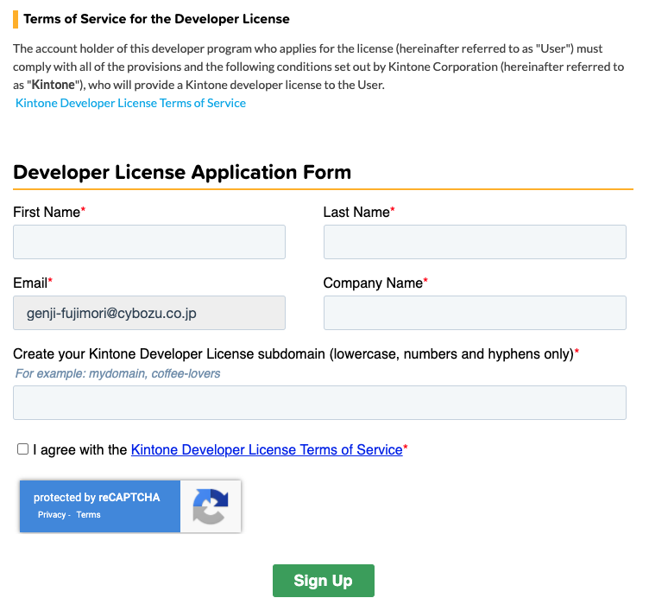
#2 - Create a Kintone Subdomain
bit.ly/K_DevLic
⚠️ No Special Characters ⚠️
⚡ Name your Subdomain with only ⚡ lowercase [a-z], numbers [0-9],
& hyphens [-]
✅ e.g. weekend-hacker, jsis4you ✅
Notes:
Speaker: 'Your email will 30-day free trial, but we will change it to 1-year developer license account in the backend'
Sign up for Kintone → https://kintone.com/developer-license/

Slide 5
Notes:
Let us build a Timeline Chart Data Viz Project!

Slide 6

This Workshop is For
Front-end developers who want to spend less time setting up their back-end infrastructure
I want to concentrate on the UI/UX of my project!

Slide 7
Today's Agenda
Get the Big Picture
1
Create a Kintone App
2
Display amCharts on Kintone
3
Call REST APIs from Kintone
4

